Slide 1

Public WIFI
DEVELOPMENT AND PRODUCTION OF COMMUNICATION EQUIPMENT
Nooran Telecom

Slide 2

Introduce Eltex Company
Notes:
This is another option for an Overview slides using transitions.

Slide 3

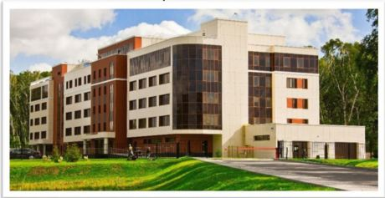
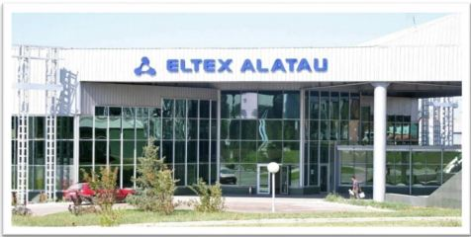
ENTERPRISE
Russian designer and manufacturer of telecommunication equipment
• 25 years of experience in designing and manufacturing of telecommunication equipment
• More than 500 employees
• 7 software development laboratories
• 2 industrial complexes (Novosibirsk, Kazakhstan)
• More than 30 partner companies in Russia, CIS and Eastern Europe
• More than 1500 client companies
• Complete cycle of development, production and technical support
• Modern automated production
• All the equipment is designed by Eltex specialists
The industrial complex in Novosibirsk
The industrial complex in Kazakhstan

Slide 4
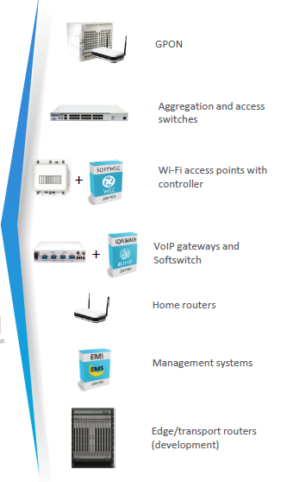
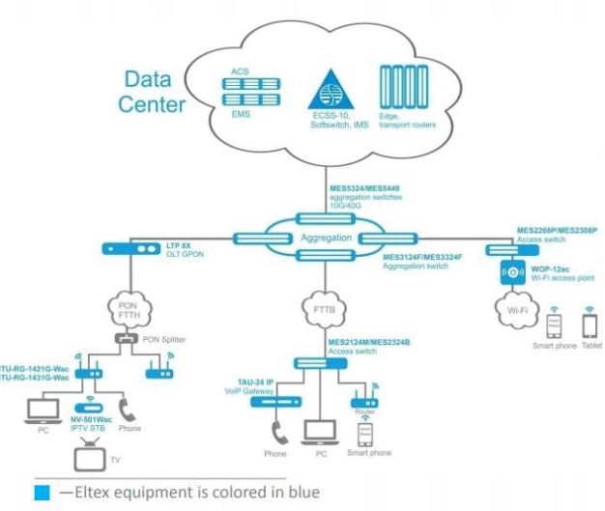
EQUIPMENT

Slide 5

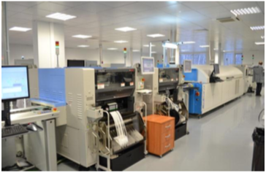
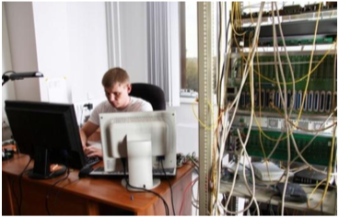
ENTERPRISE
Eltex Enterprise implements a complete production cycle
¹
²
³
^{Design}
^{Manufacture}
^{Maintenance}
^{• Hardware}
^{• Software}
^{• Surface-mount technology}
^{• Through-hole technology}
^{• Assembling}
^{• Software installation}
• Serial production equipment testing
^{• Technical support}
^{• Service center}
^{• Software updating}
^{• Warranty service and repair}

Slide 6

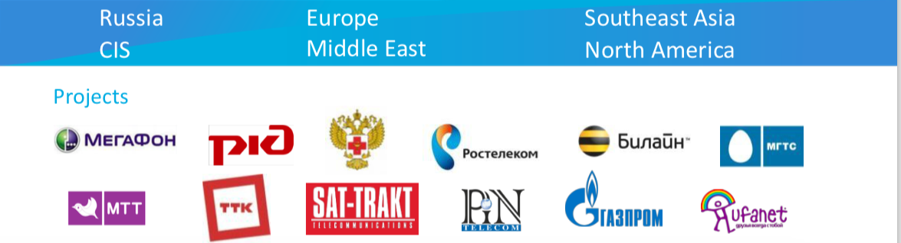
PROJECTS
^{• 7 millions of PON OLT ports}
^{• 2 millions of Ethernet ports}
^{• 2 millions of VoIP ports}
• 750 thousand of IPTV Set-top boxes
^{• 5 millions of TDM ports}

Slide 7
Public WIFI
Solutions

Slide 8
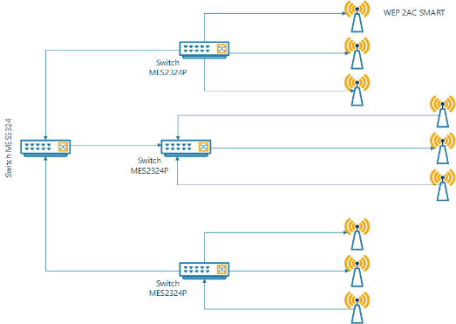
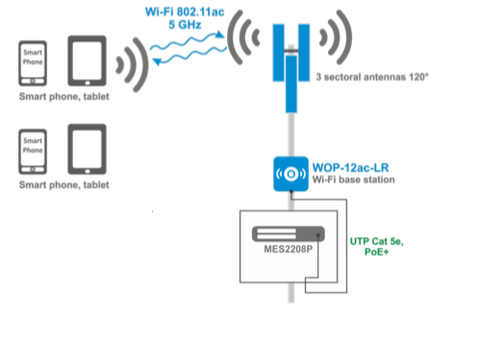
Generic Public WIFI
Generic Public WIFI Designed with ELTEX Equipment

Slide 9
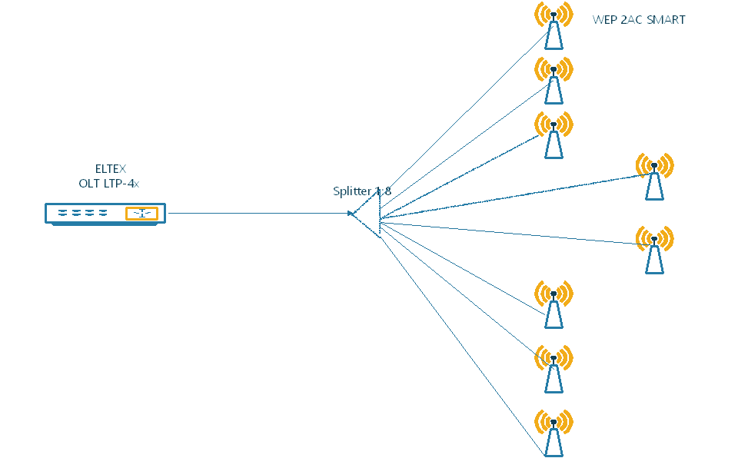
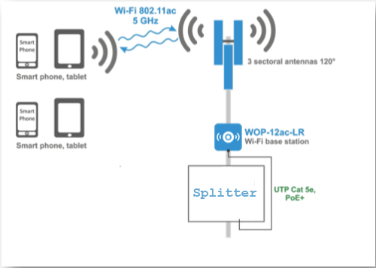
GPON Public WIFI
GPON Public WIFI Designed with ELTEX Equipment

Slide 10
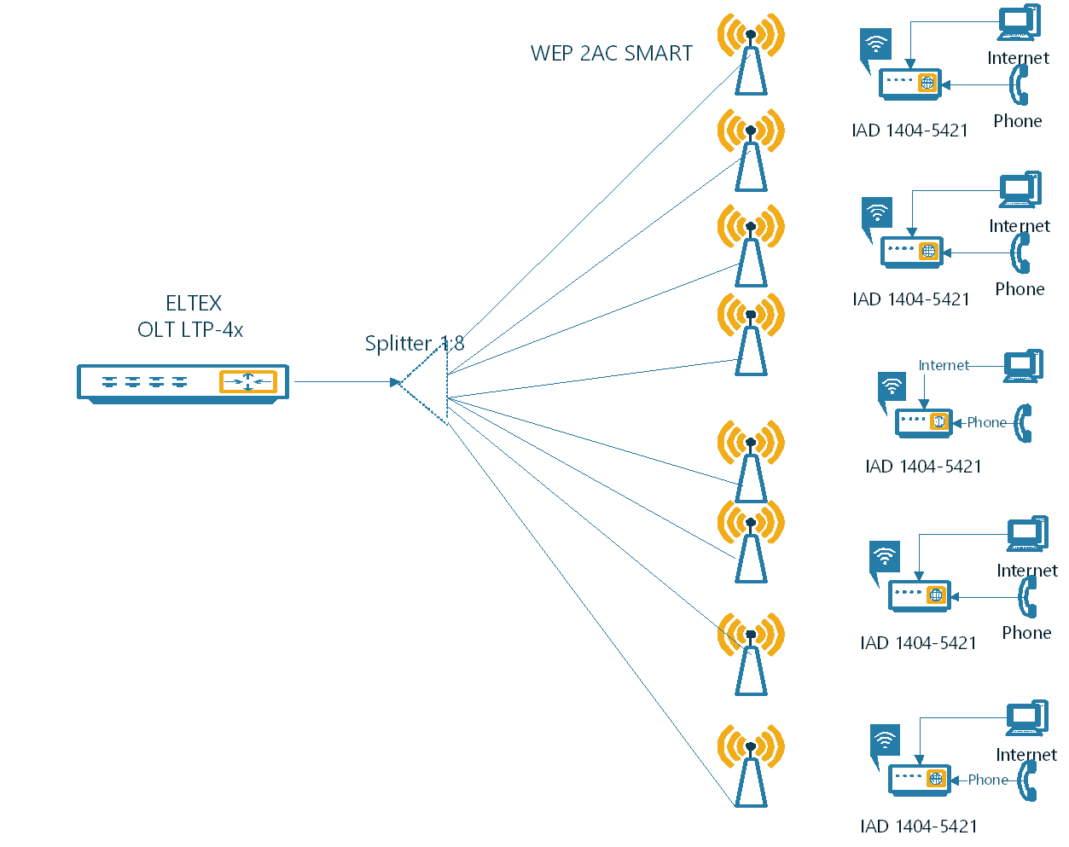
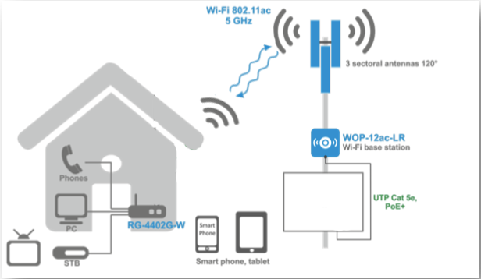
GPON with IAD Public WIFI
GPON with IAD Public WIFI Designed with ELTEX Equipment
Splitter
IAD

Slide 11
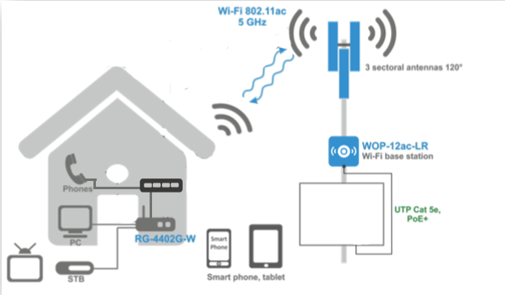
GPON with IAD AND TAU Public WIFI
GPON with IAD AND TAU Public WIFI Designed with ELTEX Equipment
TAU
Splitter
IAD

Slide 12
Public WIFI
Equipment

Slide 13
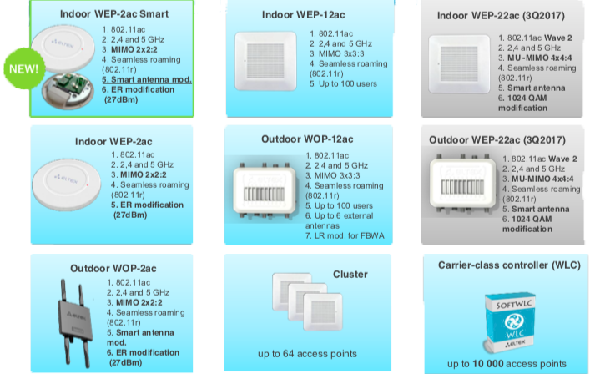
WIFI Equipment

Slide 14

ELTEX Equipment Feature

Slide 15
WIFI Feature
• Automatic configuration of the devices in cluster
• Automatic update of access points
^{• WEB portal}
^{• Seamless roaming (802.11r)}
• Channel Management (each access point select the most noisefree channel)
• Multidomain architecture allows delegating admin rights of B2B segment to a Client or service provider’s
• branch Centralized access points management (configuration, software update)
• Construction of a HotSpot in a city or region
^{• Captive Portal}
• Compliance with Russian government order No758 from 31.06.2014 (authentication via SMS, www.gosuslugi.ru)
• Management of service provision (pay access, advertising display), Wi-Fi monetizing means

Slide 16
Case Study

Slide 17
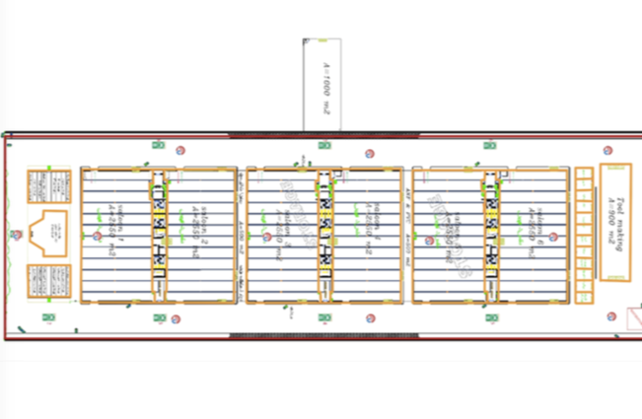
Crouse Project in Iran
^{Map with no visualizations}

Slide 18
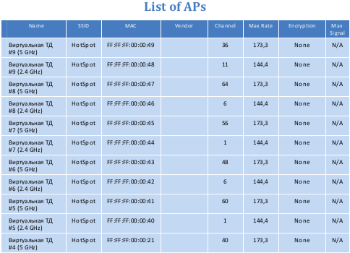
Crouse Project in Iran

Slide 19
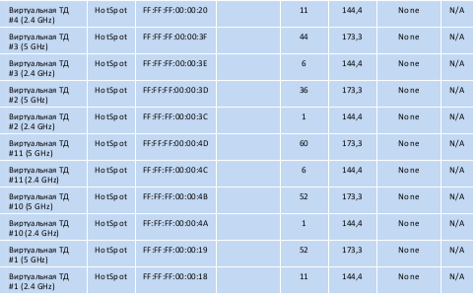
Crouse Project in Iran

Slide 20
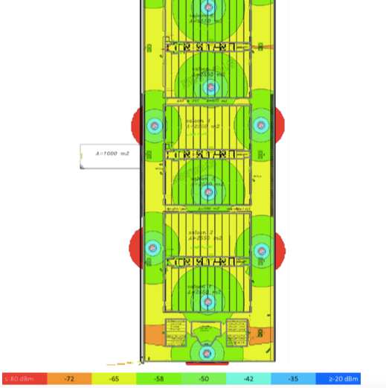
Crouse Project in Iran
^{Signal Level}

Slide 21
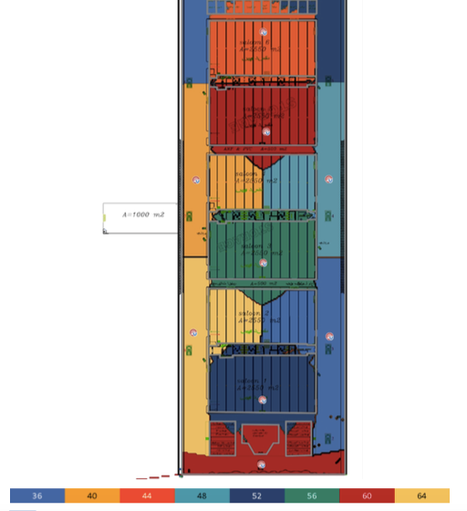
Crouse Project in Iran
^{Channel Map 2.4 GHz}

Slide 22
END

